Slide 1

Capstone Project UPDATE SEPTEMBER 2021
Automated Valuation Model (AVM)
For
Industrial Property
By
Malaika Martin

Slide 2
Step I: The data
Acquired data from CoStar through a contact at former employer, Cohnreznick, LLP in Chicago
Requested data according to the following parameters
Property Type: Industrial
Size: 50,000 SF+
Location: United States, east of the Mississippi River
Time Frame: January 2019 - present
File type: Excel

Slide 3

RECEIVED:
39 columns and 7,083 rows of data, each representing sales either closed or in contract as of April 15, 2021
Columns:
Property Address, Property City, Property State, Property Type, Building SF, Star Rating, Sale Price, Price Per SF, Sale Date, Sale Status, Asking Price, Actual Cap Rate, Pro Forma Cap Rate, Property Name, Buyer (True) Company, Buyer (True) Origin, Buyers Broker Company, Seller (True) Company, Seller (True) Origin, Listing Broker Company, Secondary Type, Building Class, Year Built, Land Area AC, Land Area SF, Number Of Floors, Ceiling Height, Zoning, Submarket Name, Location Type, Property County, Property Zip Code, Map Code, Recording Date, Publication Date, Non-Arms Length Reasons, Sale Price Comment, Research Status, Transaction Notes
CoStar data is designed for brokers, appraisers and other professionals who use CoStar as a starting point for research into specific transactions. It also enables larger demographic analysis.

Slide 4
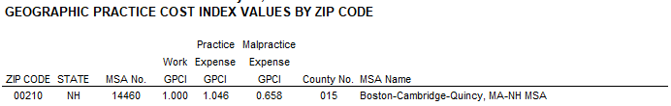
Additional Data
U.S. Department of Labor, Office of Workers’ Compensation Programs
Geographic Practice Cost Index Values by Zip Code
Practice Expense GCPI: Adjusts for geographic variation in the direct costs of providing services and the indirect costs of maintaining a clinical practice, including administrative and clinical staff compensation (salary and benefits), rent, and supplies and equipment. Accounts for 43.7% of geographic adjustment on average.
Used Practice Expense GCPI as a proxy for general cost of living

Slide 5
Additional Data
Geodata: YouTube Video: Calculating Distance In Excel
(https://www.youtube.com/watch?v=cpUVV8q7WNo)
Downloaded Excel file containing formula to convert zip codes to geodata and then compute the distance between two points using the following formula:
(=ACOS(COS(RADIANS(90-B2))*COS(RADIANS(90-H2))+SIN(RADIANS(90-B2))*SIN(RADIANS(90- H2))*COS(RADIANS(C2-I2)))*3958.8)

Slide 6
Additional Data
List of Major Highway Interchanges in the Eastern United States (Wikipedia)

Slide 7
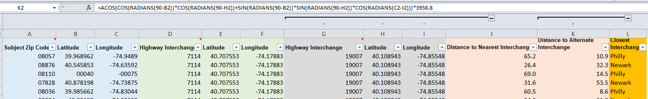
List of Major Highway Interchanges in the Eastern United States (cont.)

Slide 8
Step ii: Processing the Data
Many of the columns were irrelevant, so many of the columns were deleted
Remaining Columns: Sale Price, Price Per SF, Sale Date, Sale Status, Secondary Type, Land Area AC, Number Of Floors, Ceiling Height, Location Type, Property Zip Code
New Columns: MSA, Nearest Major Highway Interchange, Distance to Nearest Interchange
Ceiling height was in traditional feet and inches. Had to be converted to decimals using a formula from Microsoft Answers. Any ranges were averaged manually

Slide 9
Step ii: Processing the Data
Began with NY/NJ/PA area and 522 rows of data from previous phase of analysis
Deleted columns that did not have Ceiling Height and multiple building sales, which brought number of rows to 3,515
Unlike first phase, kept data in all MSAs even if there was 1 datapoint in that MSA
FINALLY THE TIME HAD COME TO TURN TO PANDAS/SKLEARN

Slide 10
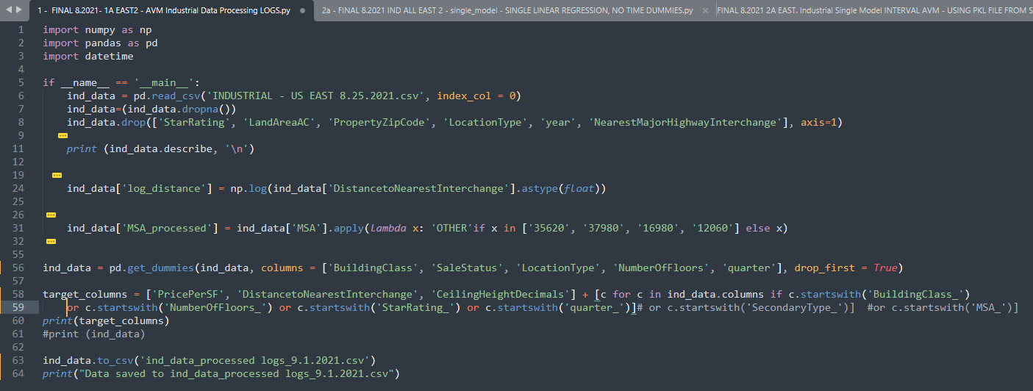
CREATING OLS REGRESSION AND PKL FILES

Slide 11
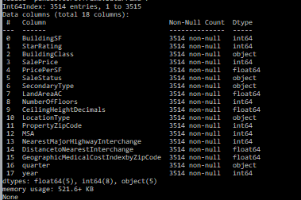
Dataframe Info

Slide 12
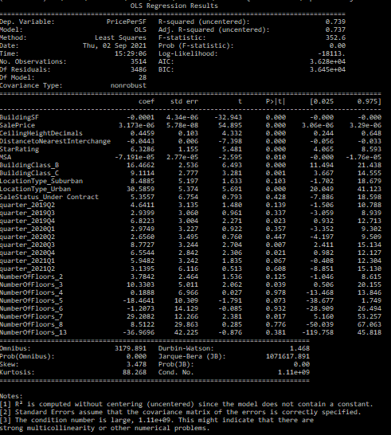
Ols regression - results
Dependent Variable (y): Price Per SF
R² = from 0.437 to 0.739

Slide 13
Most significant variables (p-values <0.05):
Building SF | Location Type: Urban
Sale Price | Quarter: 2019 Q4
Ceiling Height (Decimals) | Quarter: 2020 Q3
Distance to Nearest Interchange | Quarter: 2020 Q4
Star Rating | Quarter: 2021 Q1 (borderline)
MSA | Number of Floors: 3
Building Class B | Number of Floors: 5
Building Class C | Number of Floors: 7 (borderline)

Slide 14
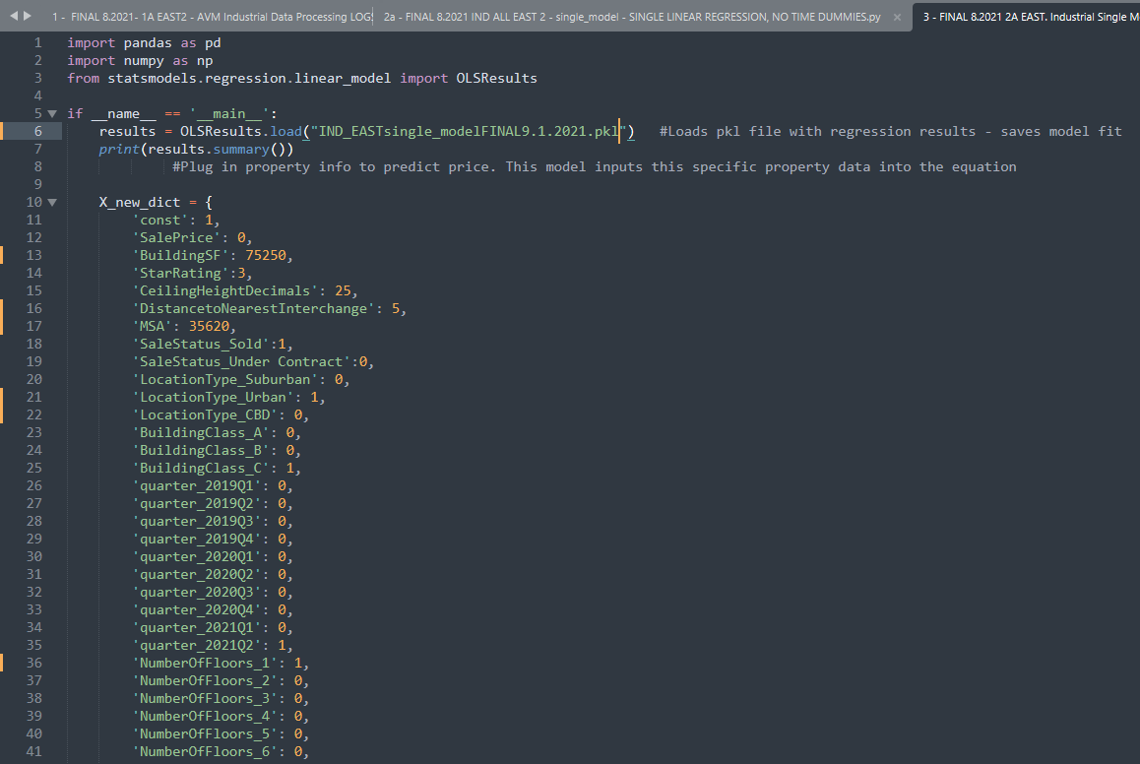
Interval prediction
Add a 1 next to the characteristics you want to select to go into the model, add a 0 to deselect

Slide 15
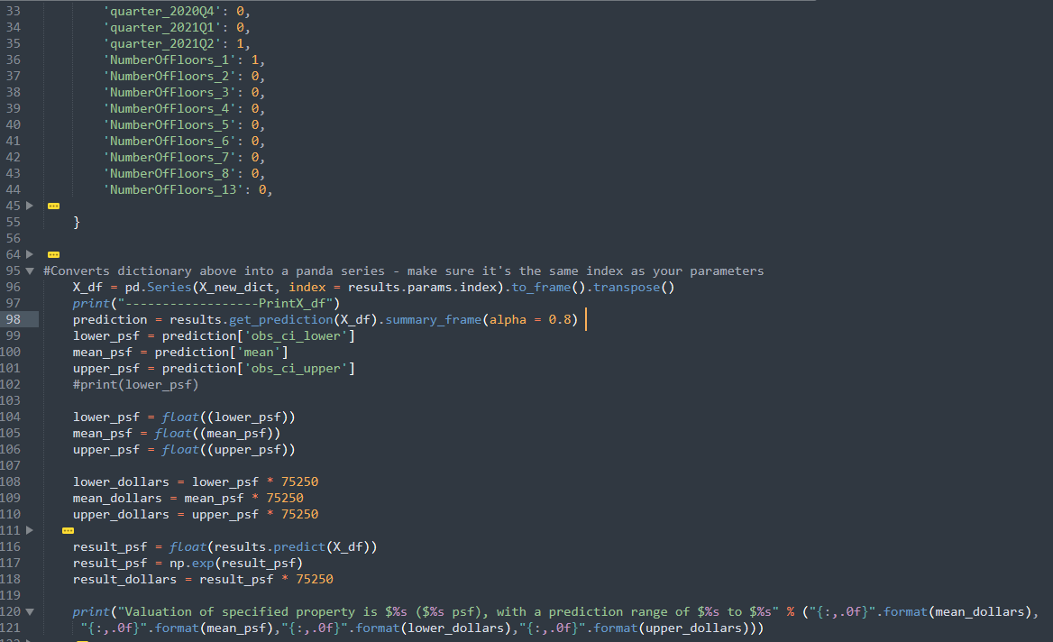

Slide 16
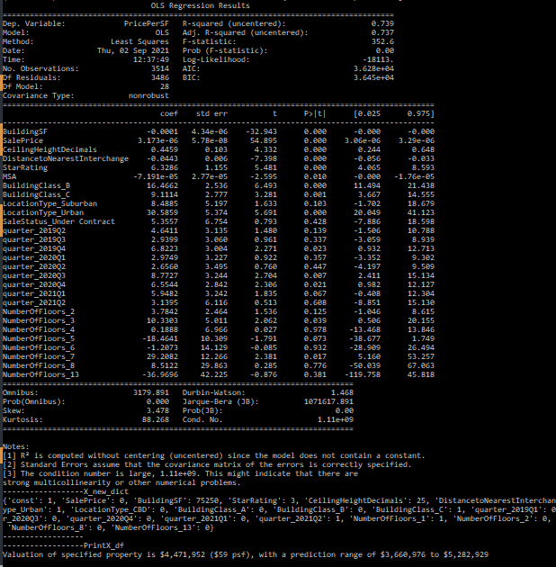
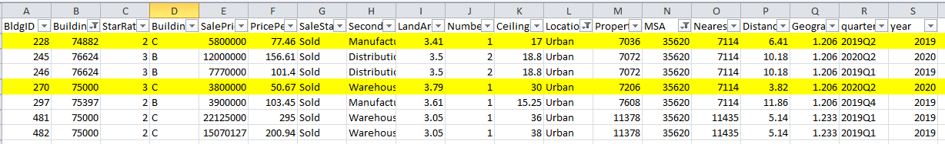
Results: $4,471,952 ($59 PSF) with range between $3,660,976 and $5,282,929
From original dataset

Slide 17
The current model attempts to account for size, location, property condition and market characteristics given the information available from CoStar. Future iterations will attempt to link the Geographic Cost Index to the property zip code and weight the influences of different characteristics. A rolling model is also currently in the works in order to make predictions into the future. The ultimate goal is to develop the current model into a tool valuation professionals can use to produce valuations more efficiently without sacrificing accuracy.

Slide 18
Please feel free to contact me with
any questions,
comments or recommendations
E-mail: mvmartin2020@gmail.com
LinkedIn: https://www.linkedin.com/in/malaika-martin-67aa0b/

